Slide 1
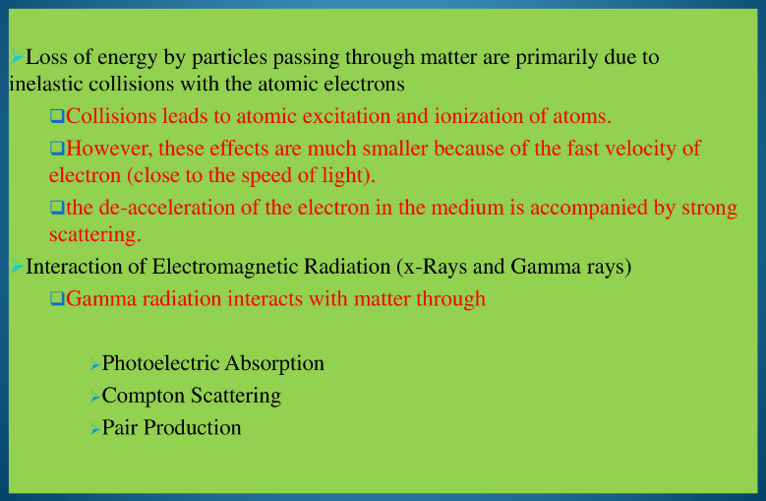

Slide 2
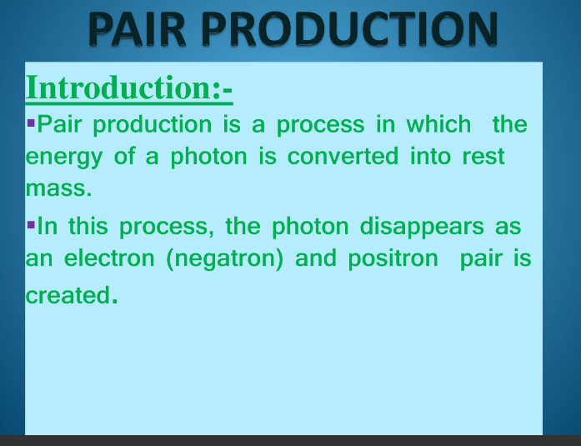

Slide 3
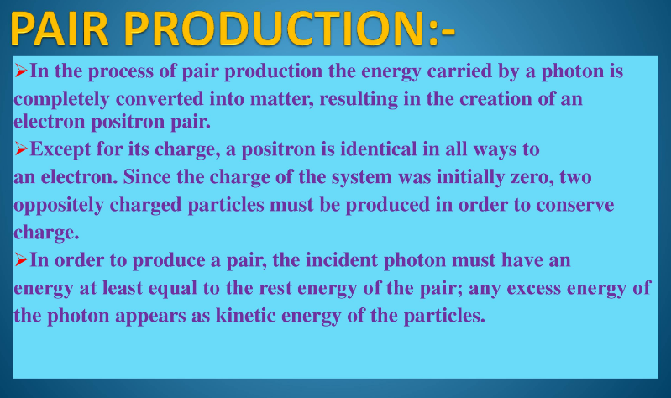

Slide 4
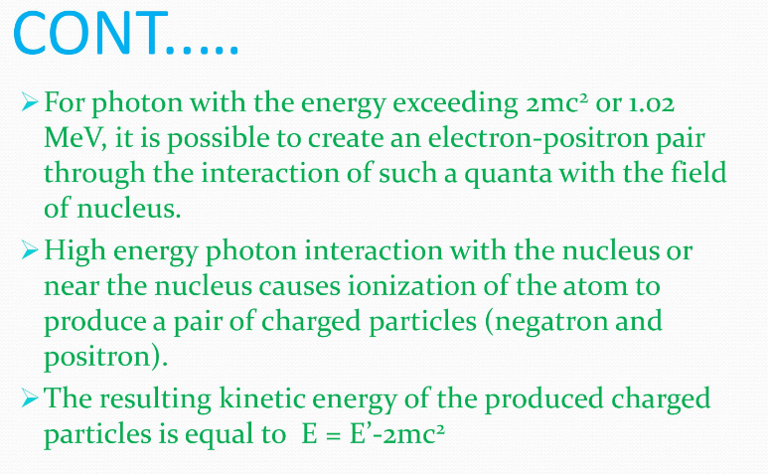

Slide 5
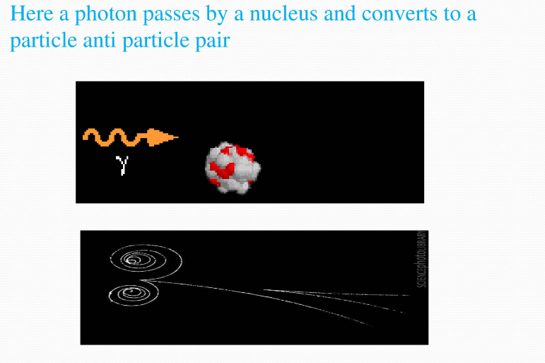

Slide 6
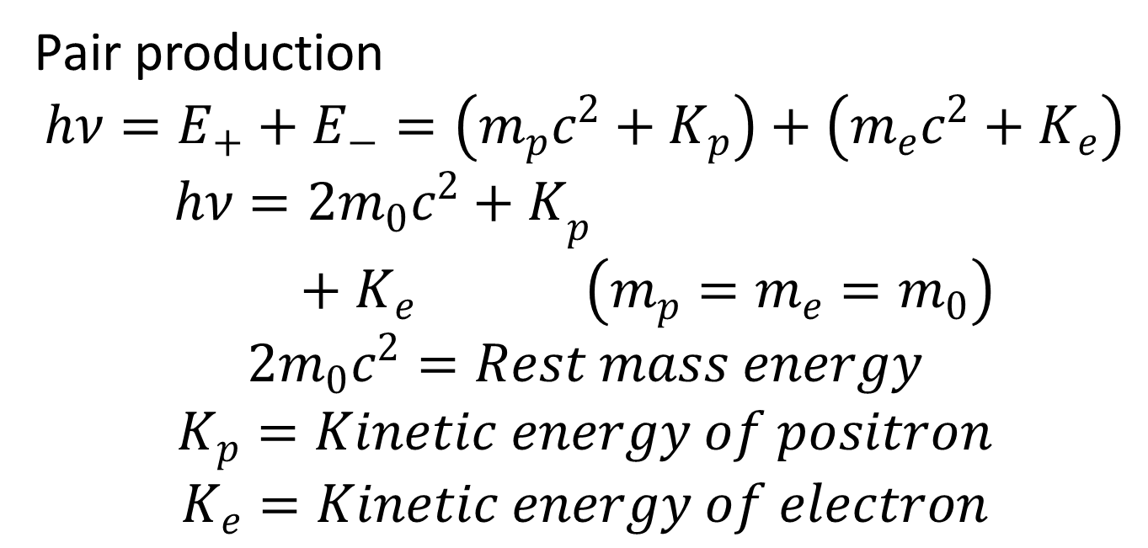
Pair production
$$hν=E_{+}+E_{−}=\left(m_{p}c^{2}+K_{p}\right)+\left(m_{e}c^{2}+K_{e}\right)$$
$$hν={2m_{0}c^{2}+K}_{p}+K_{e } \left(m_{p}=m_{e}=m_{0}\right)$$
$$2m_{0}c^{2}=Rest mass energy$$
$$K_{p}=Kinetic energy of positron$$
$$K_{e}=Kinetic energy of electron$$
Positron
Electron

Slide 7
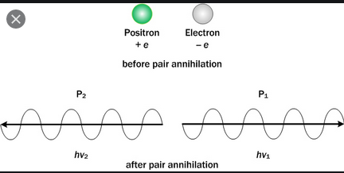

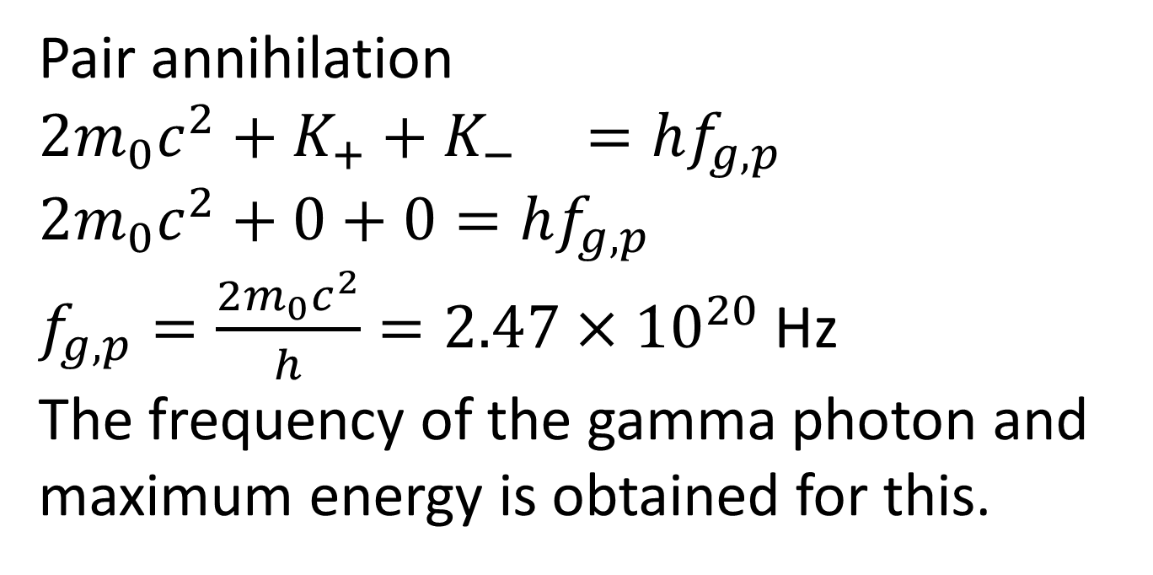
Pair annihilation
$${2m_{0}c^{2}+K}_{+}+K_{− }=hf_{g,p}$$
$$2m_{0}c^{2}+0+0=hf_{g,p}$$
$f_{g,p}=\frac{2m_{0}c^{2}}{h}=2.47×{10}^{20}$ Hz
The frequency of the gamma photon and maximum energy is obtained for this.

Slide 8
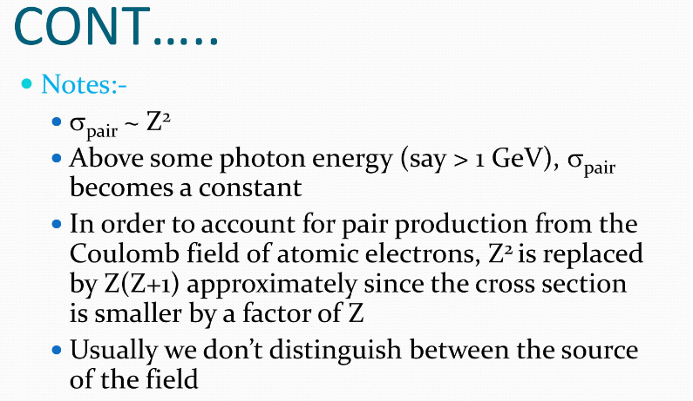

Slide 9
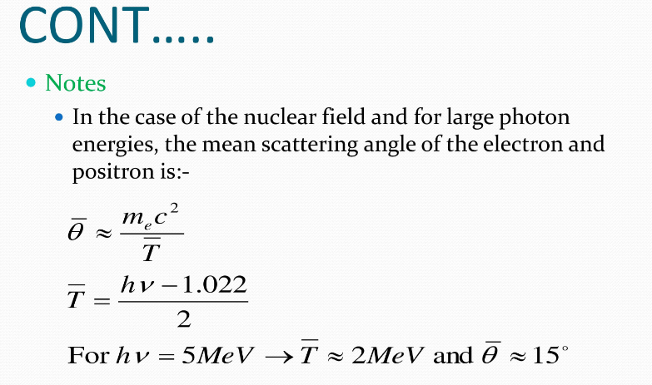

Slide 10
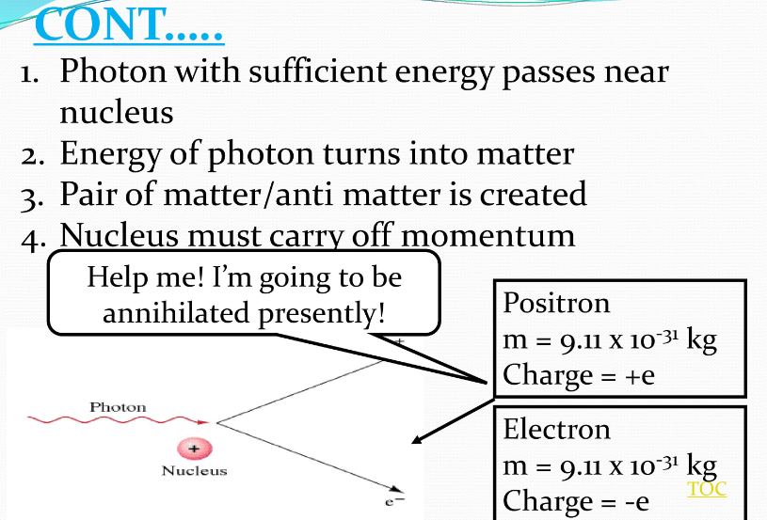

Slide 11
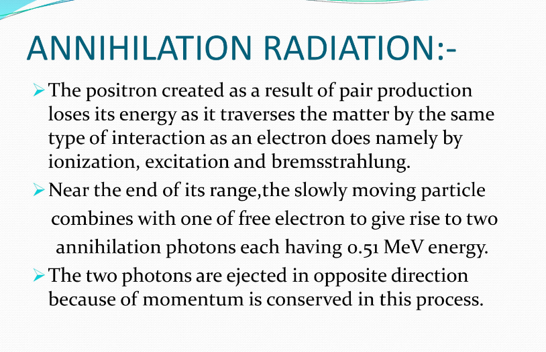

Slide 12
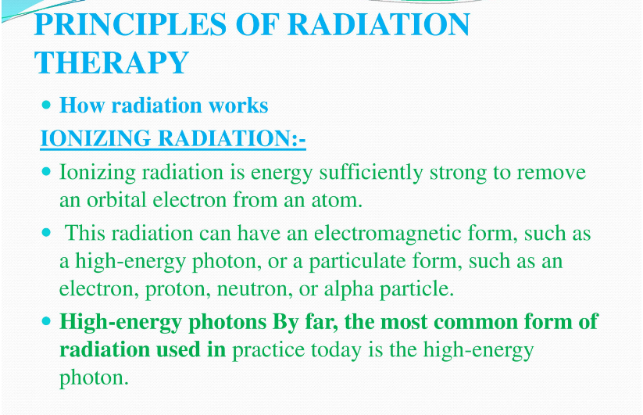

Slide 13
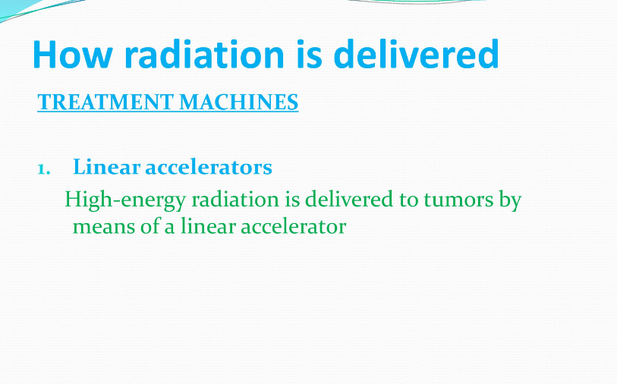

Slide 14
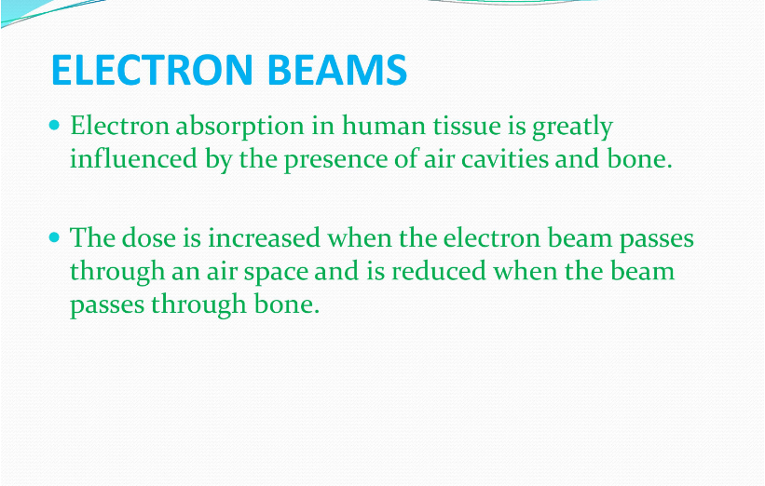

Slide 15
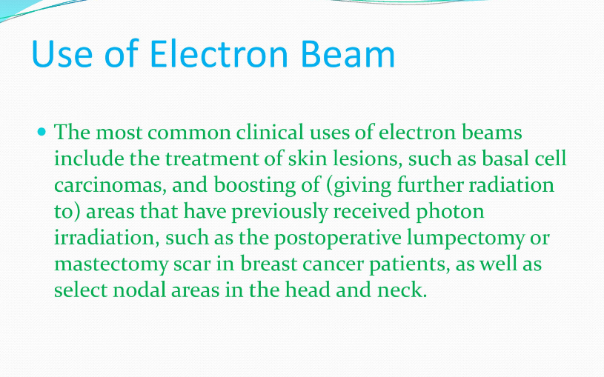

Slide 16
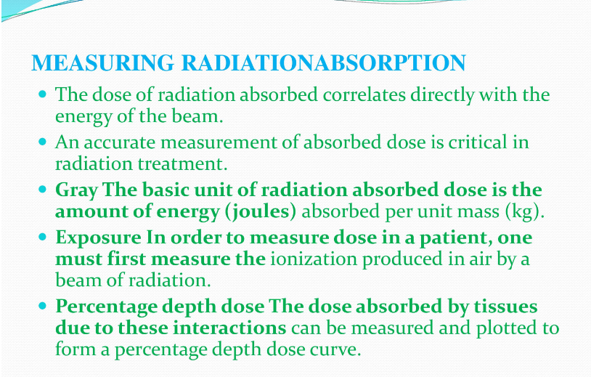

Slide 17
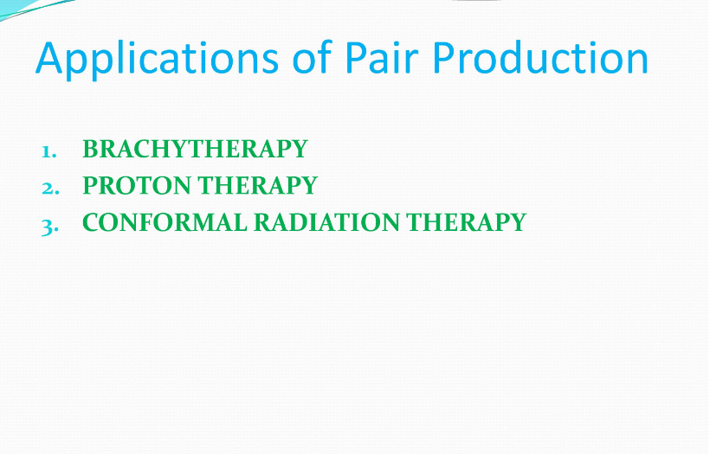

Slide 18
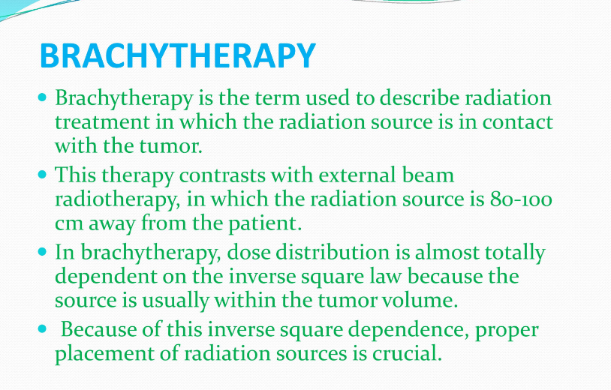

Slide 19


Slide 20
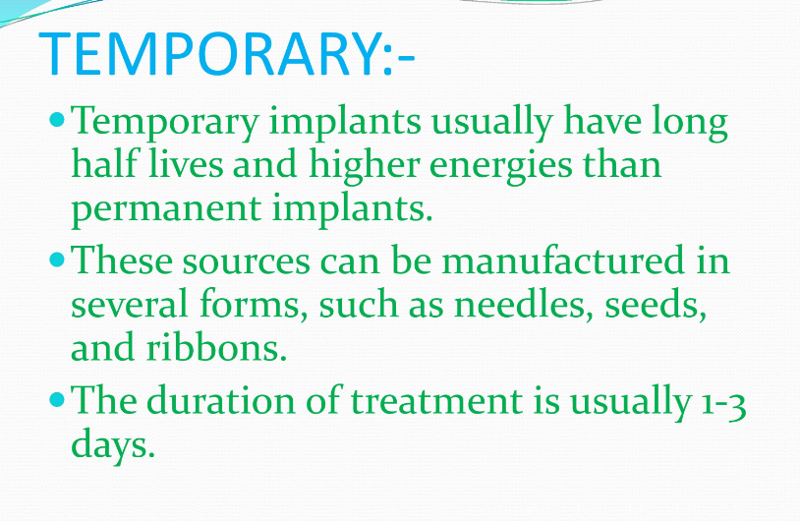

Slide 21
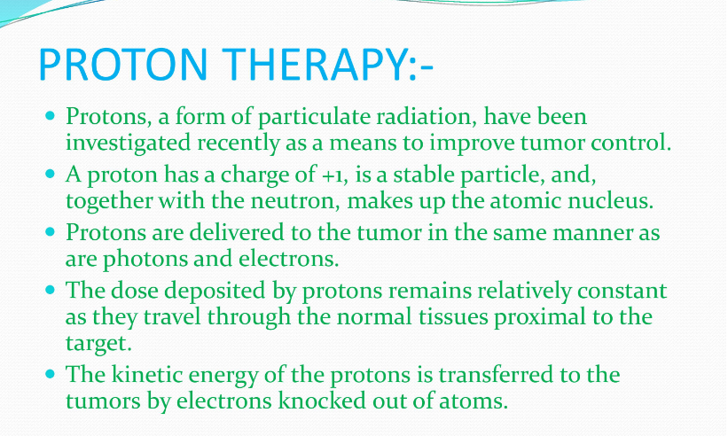

Slide 22
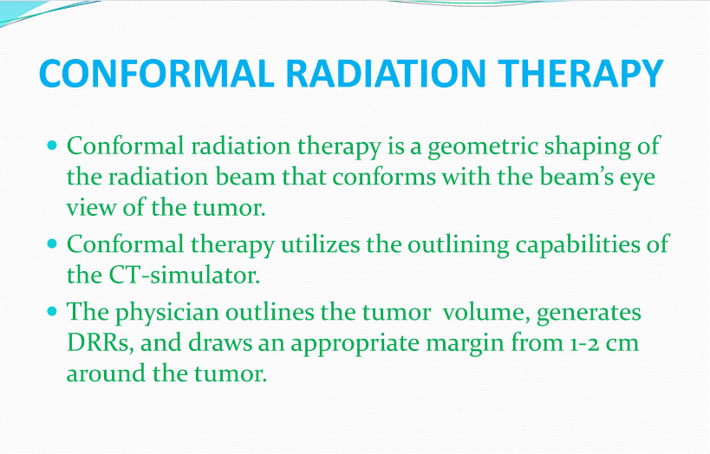

Slide 23
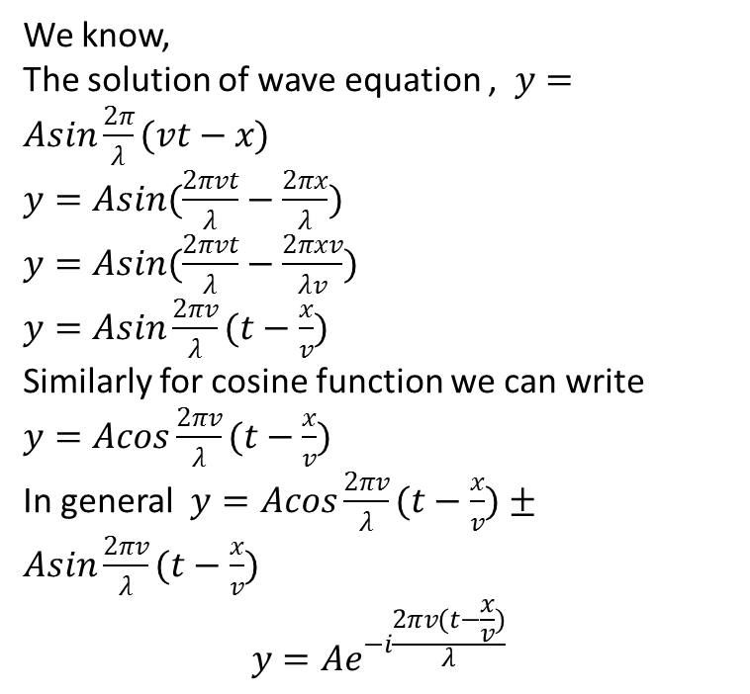
How can we write the equation of travelling wave in terms of exponential form?
We know,
The solution of wave equation , $y=Asin\frac{2π}{λ}(vt−x)$
$y=Asin(\frac{2πvt}{λ}−\frac{2πx}{λ})$
$y=Asin(\frac{2πvt}{λ}−\frac{2πxv}{λv})$
$y=Asin\frac{2πv}{λ}(t−\frac{x}{v})$
Similarly for cosine function we can write
$y=Acos\frac{2πv}{λ}(t−\frac{x}{v})$
In general $y=Acos\frac{2πv}{λ}(t−\frac{x}{v})±$ $Asin\frac{2πv}{λ}(t−\frac{x}{v})$
$$y=Ae^{−i\frac{2πv(t−\frac{x}{v})}{λ}}$$

Slide 24
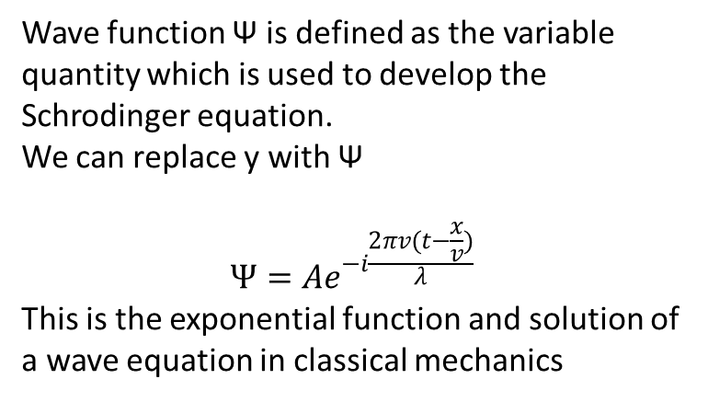
Wave function Ѱ is defined as the variable quantity which is used to develop the Schrodinger equation.
We can replace y with Ѱ
$$Ѱ=Ae^{−i\frac{2πv(t−\frac{x}{v})}{λ}}$$
This is the exponential function and solution of a wave equation in classical mechanics

Slide 25
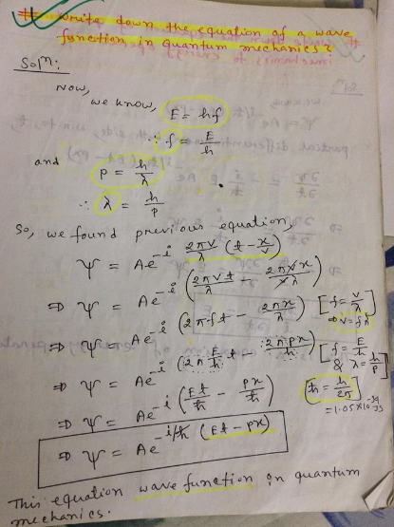

Slide 26
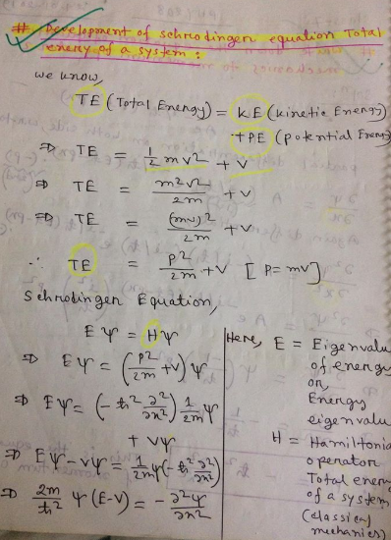

Slide 27
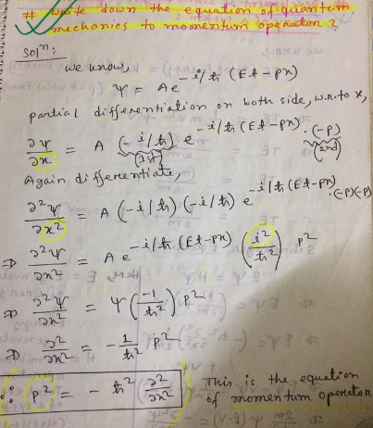

Slide 28
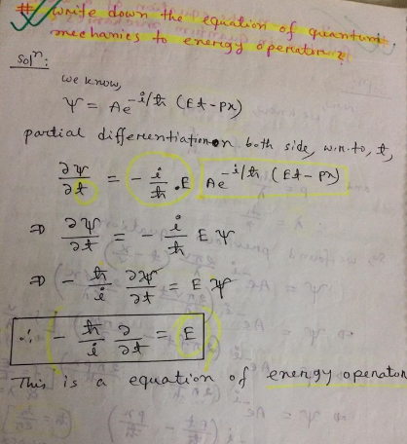

Slide 29
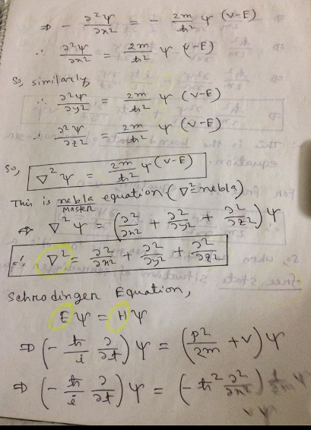

Slide 30
